Slide 1
DS_Dominos - Predictive Purchase Order System
By,
Monika

Slide 2
Problem Statement
Dominos wants to optimize the process of ordering ingredients by predicting future sales and creating a purchase order.
By accurately forecasting sales, Dominos can ensure that it has the right amount of ingredients in stock, minimizing waste and preventing stock outs.
project aims to leverage historical sales data and ingredient information to develop a predictive model and generate an efficient purchase order system for next one week.

Slide 3
BUSINESS USE CASE
Inventory Management: Ensuring optimal stock levels to meet future demand without overstocking.
Cost Reduction: Minimizing waste and reducing costs associated with expired or excess inventory.
Sales Forecasting: Accurately predicting sales trends to inform business strategies and promotions.
Supply Chain Optimization: Streamlining the ordering process to align with predicted sales and avoid disruptions.

Slide 4
Data Preprocessing
Data Cleaning ensures the dataset's accuracy and consistency through:
Handling Missing Data:
Detected missing values.
Replaced missing values using mean, median, mode, or placeholders.
Removed columns or rows with excessive missing data if necessary.
Removing Inconsistent Data:
Checked for format consistency and valid ranges.
Fixed inconsistencies, such as standardizing text and correcting typos.
Handling Outliers:
Identified outliers using statistical methods or visualizations.
Removed, transformed, or categorized outliers based on their impact.

Slide 5
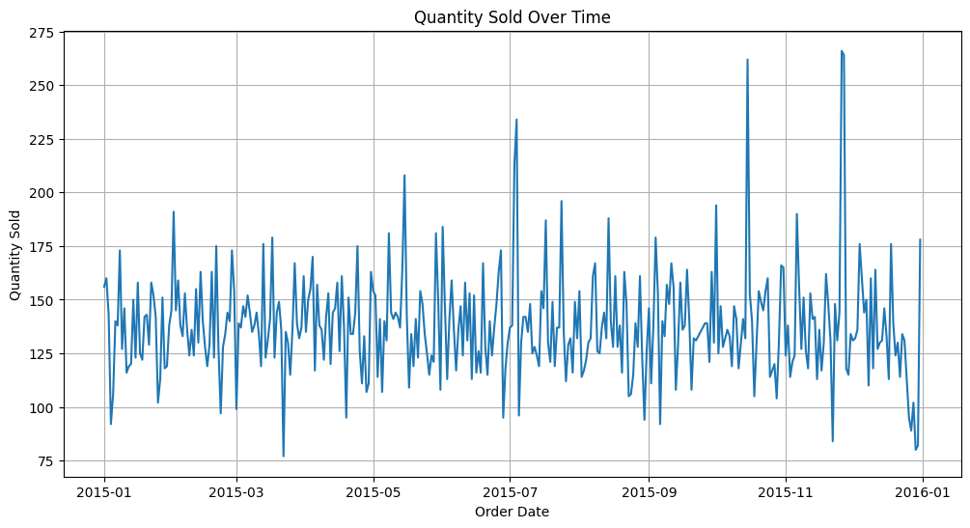
EDA

Slide 6
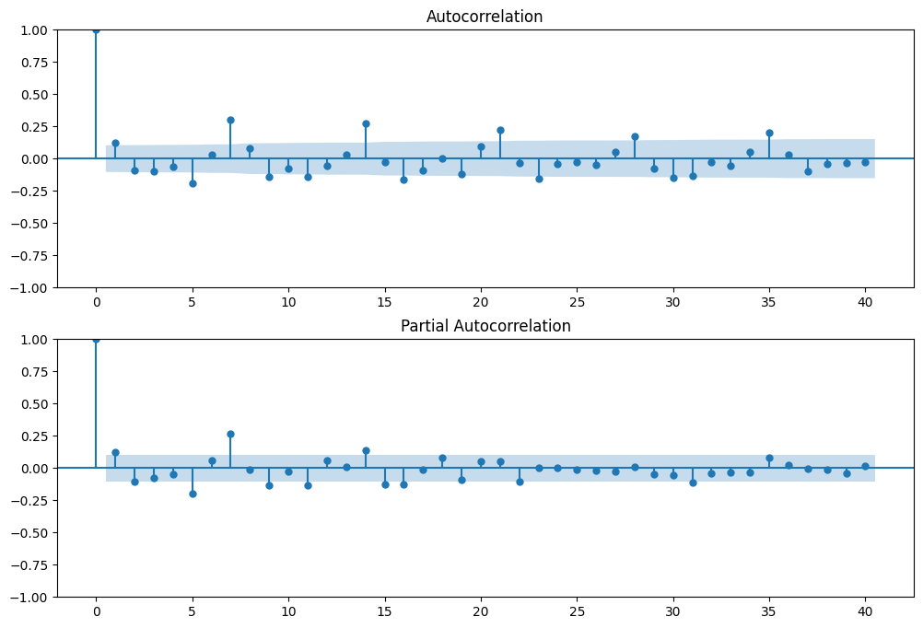
ACF and PACF

Slide 7
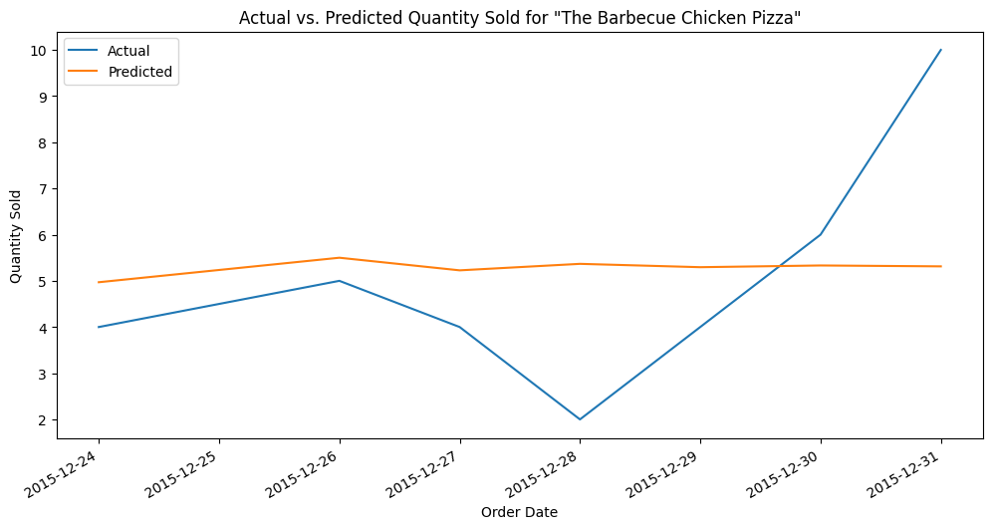
Arima model evaluation

Slide 8
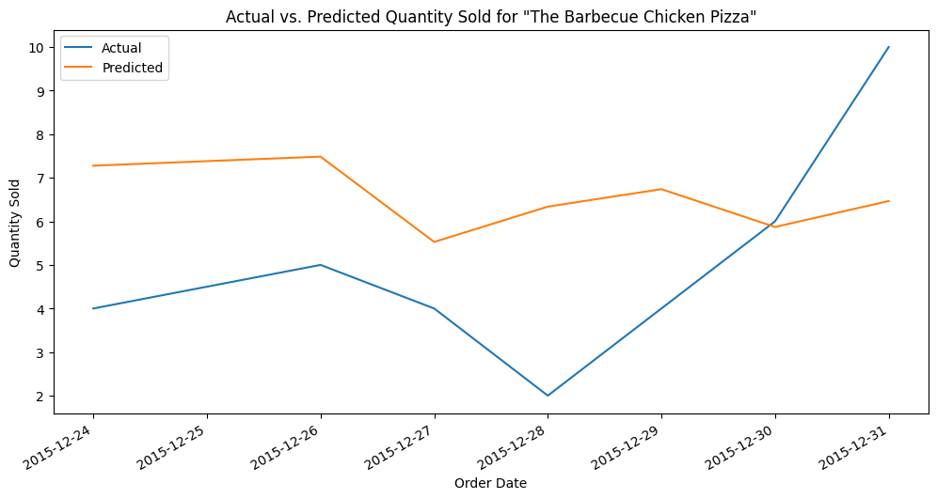
Sarimax model

Slide 9
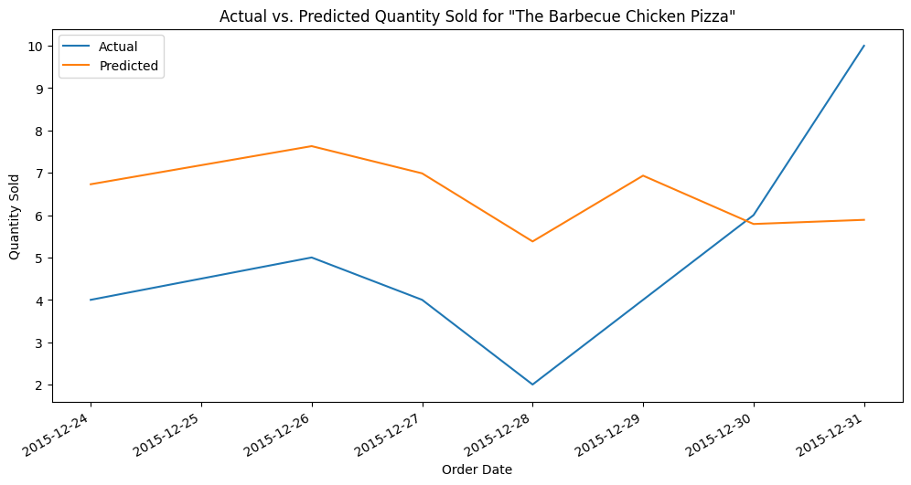
Prophet model

Slide 10
RESULT
The project delivers highly accurate pizza sales forecasts, providing precise predictions for the upcoming week. These forecasts enable better planning and optimized inventory management. Based on the predicted sales, a comprehensive purchase order is generated, detailing the exact quantities of each ingredient required. This ensures that the necessary ingredients are stocked efficiently, minimizing waste and avoiding shortages. The result supports seamless operations by aligning supply with demand, improving both supply chain efficiency and overall business performance.

